Slide 1
Module summary

Slide 2
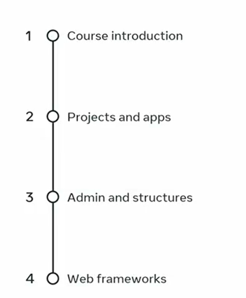

Slide 3
Text content
Media files
Heavy traffic

Slide 4
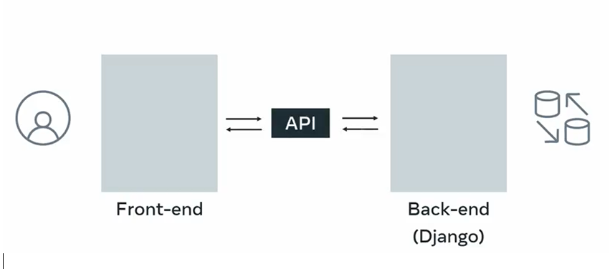
Dynamic Website

Slide 5
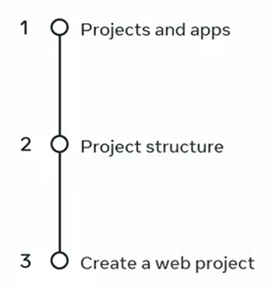

Slide 6
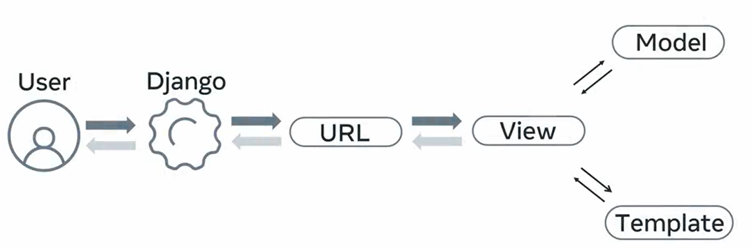

Slide 7


Slide 8


Slide 9
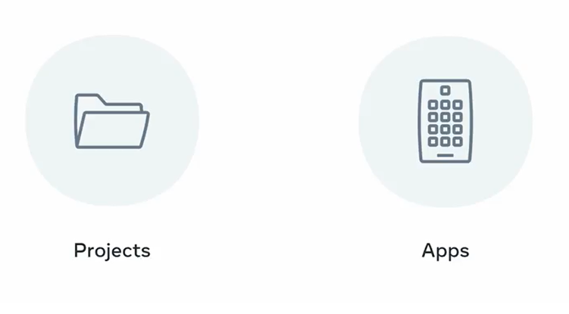

Slide 10

Create an app

Slide 11
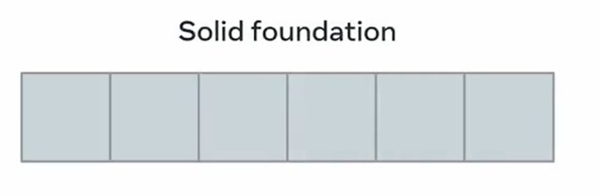
Web framework

Slide 12
Fast development
Clean structure
Change and modify
Code reusability

Slide 13
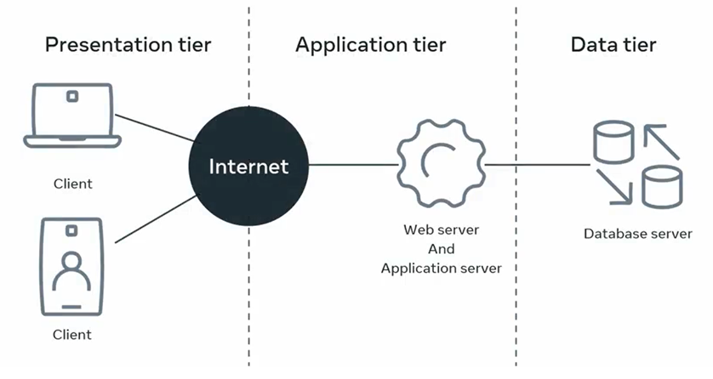

Slide 14
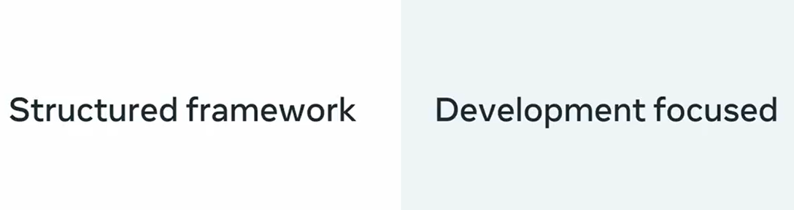

Slide 15
Fast
Feature-rich
Secure
Scalable

Slide 16
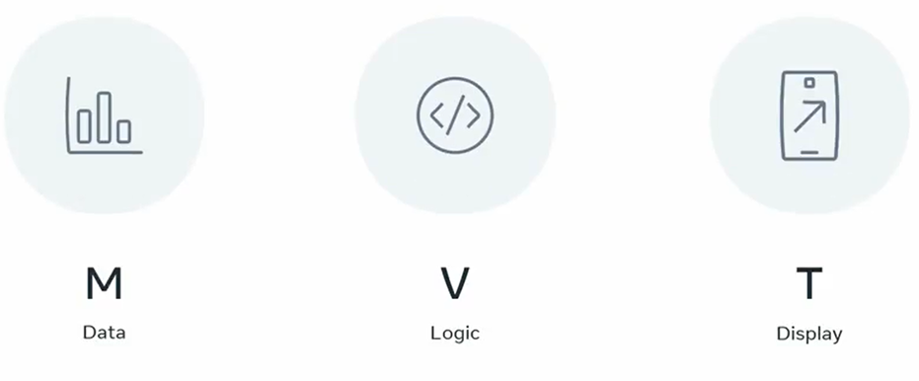

Slide 17

MVT
Reusability of code
Create an app
Text to a homepage

